Slide 1
Linux

Slide 2
SUDO SU - → To convert to the root user
CD → Change directory
PWD/Who am i → Present Working Directory
Vi , vim, touch → Used to create files
Ls , ls –ll , ls –a → Display the available files and directory's inside the filesystem
Grep , find , less , tail , more , head , cat → command used for file handling
cat > <filename> → Open the file
Clear → To clear on-screen text
Exit → To exit from screen
RM XXX → To remove the file where xxx is file name
rm –rf <filename> → same as above line
Ctrl+C → Help us to entre the commands in normal way
mv <source file> </dest> → move and rename the files

Slide 3
Linux Basic Commands
Uname - a, r, m → Display OS , kernel, architecture of linux
Uptime → Display system uptime information with load average
dmidecode → Display CPU information and hardware information
Vmstat → Display the memory info
Free –m , h → Display memory usage and buffer catch information along with swap
Df –h → Display filesystem utilization
Fdisk –l → Display available disks and LUN , created partitions
Du –sh → Display disk and file utilization on filesystem (Eg: du –sh | sort –nr |head -10)
Man <command> → gives help to usage of command

Slide 4
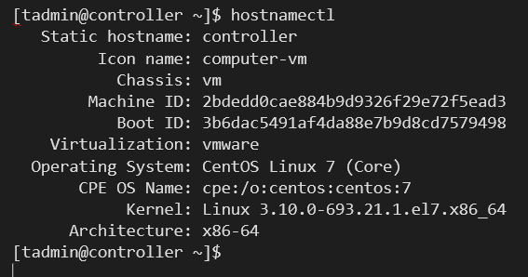
mkdir <dir name>/mkdir –p <dir name> → used to create the directory
rmdir < dir name >/rm –rf < dir name > → Used to delete directory
Cp <source file> </dest> → copy the files from one location to other
scp <source file> root@<ip>:/home/<dest> → copy the files remote to remote
ssh user@<ip/hostname> → To login remote location from linux
Ssh –I access.pem ec2-user@172.17.1.4
Ping <ip/hostname> → To check host is available
Ip a, ifconfig , ifup ens33, ifdown ens33 →to check network interface, MAC address, assigned IP information. Bring interface up and down.
Hostnamectl → provides

Slide 5

hostname –I, hostname → provides
top, ps –ef , kill -9 <P.ID> , killall <p.name>
System service:
Systemctl status| start|restart|stop|enable <service name> → 7 version
Service <service name> status| start|restart|stop
Chkconfig httpd on → permanently enable the service on run time

